Slide 1
NLP Based E-Commerce AI
Group 2
Ashish Mehra, Akhil Chelikani and Kaiyue Liu

Slide 2
Summary
E-Commerce, a lot of products, many reviews
Use what we learned this class in NLP:
Understanding customer reviews online
Using vectorizer for pre-processing and vectorizing
Using LDA to identify clusters, (TFIDF result was less interpretable)
Mapping topics clusters with semantic features manually
Understanding products and topics based on reviews
Aggregate on each level to provide insights
Model validity/accuracy showcase
Demo and QA

Slide 3
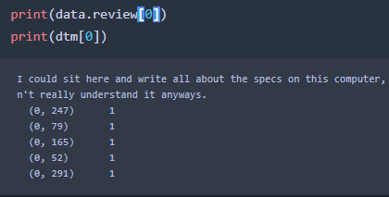
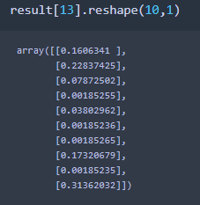
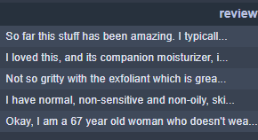
Project Workflow
Topic Analysis
Reviews Database
LDA
NMF
Truncated SVD
Vectorizer
TFIDF/DTM
Product Knowledge

Slide 4
Dataset
Amazon reviews of all products in a keyword search:
“Laptops”
Contains 15000+ reviews of 300 products
Reviews generally have good quality, people comment seriously

Slide 5
Pre-processing
Count Vectorizer
LDA,
Result was interpretable.
TFIDF Vectorizer
NMF
SVD
Results were not as good, 3+ topics had essentially same terms

Slide 6
Topic Modeling
Topic modeling can reveal semantics
Examine terms manually to label topics with semantics
Storage vs Heating vs Battery
We used a 10-topic model:
0: User subjective experience
1: Heating Problems
2,3: School and Family
4: Good reviews
5: Storage & Specs
7: Battery Life
9: Performance
Not all topics are as significant:
2&3 are more general, friends and family reviews
Heating, Battery, Spec, and Performance are more significant, having stronger sentiment and more information
From reviews we aggregate to:
Product Knowledge
Topic Knowledge

Slide 7
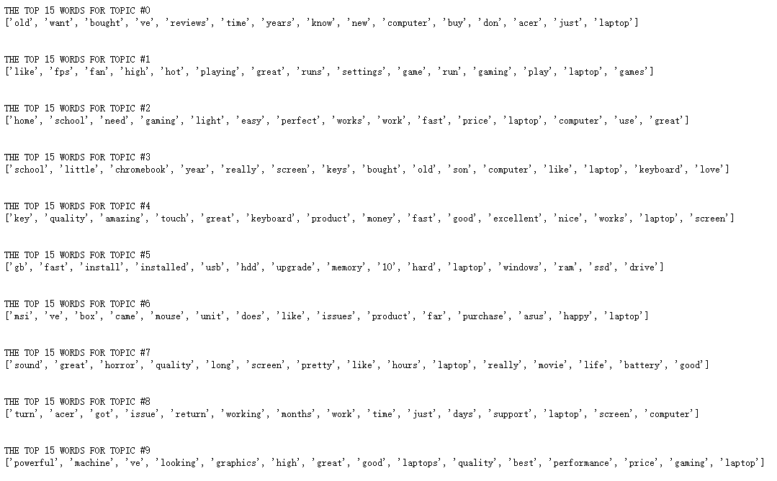
Topic & Terms

Slide 8
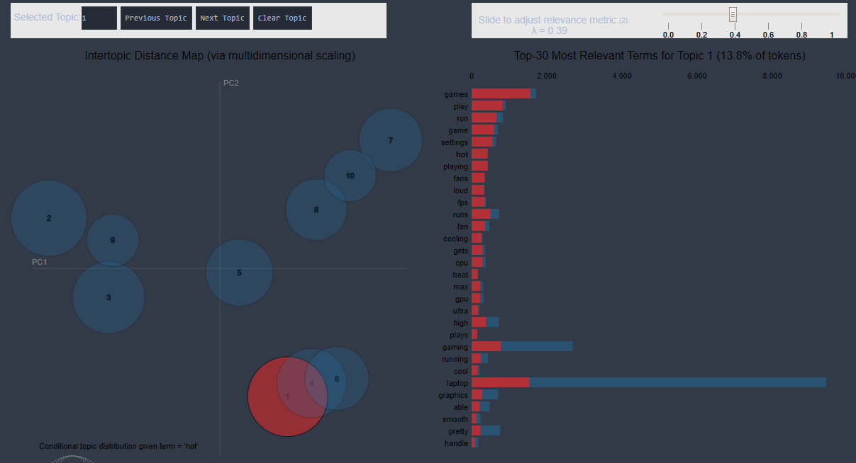
Visuals Demo

Slide 9
Review Example
Be sure to always be near a outlet if you want to do anything with this laptop. I have had this laptop for three months now and the battery life is horrible. When doing simple things like surfing the web or watching youtube, you will only get a hour and a half or so at best. When gaming, don't bother unless you're plugged in. All the reviews I read prior to buying it claimed that the battery life was 3-4 hours when surfing the web. That never happened for me once. If you want a budget gaming laptop with a better battery life, please look elsewhere.
45% Topic 7 (Battery Life), 33% Topic 0 (Use expeirence)

Slide 10
Review Example
I have had my Zephyrus S for a few days now and really like the performance. I chose this laptop over the MSI GS65 Stealth due to the specs bejng better slightly better and the cooling system having better reviews. This laptop does not disappoint performance wise and cooling. I play the provided Call of Duty at max setting for a few hours at a time and the cpu and GPU temp average about 65 degrees. The battery is not as great as the stealth, but that does not bother me because I mainly have the laptop plugged in . So far my only complaint, which is why I am only giving 4/5 stars, is that the screen bleed which started after a couple days of having it, is the worst I have ever expierenced. I will be contacting support this see how this can be fixed because it is quite distracting. Also, note that this laptop does not come with a Ethernet port or a Thunderbolt port, the wireless card does work great though. Some boxes came with a USB to Ethernet cords, but mine did not so I had to go out and buy one for about $20. The picture I included shows the screen bleed I had last night.
27% Topic 1 (Heating) 16.5 % Topic 7 (Battery Life) 21.8% Topic 8 (Experience)

Slide 11
Review Example
I have had this laptop for a few weeks, gaming on a daily basis and so far I am very impressed. The laptop is good with multi-tasking as it comes with the I5-8300h quad core cpu. The included 256GB SSD drive performs well and the machine boots super fast.
49.5% Topic 5 (Storage) 45% Topic 9 (Performance)

Slide 12
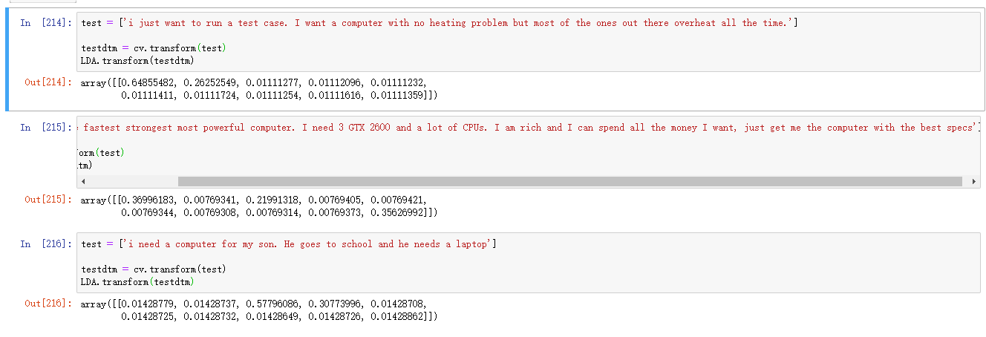
Test Cases
Topic 1 (Heating)
Topic 9 (Performance)
Topic 2&3 (Friends and Family)

Slide 13
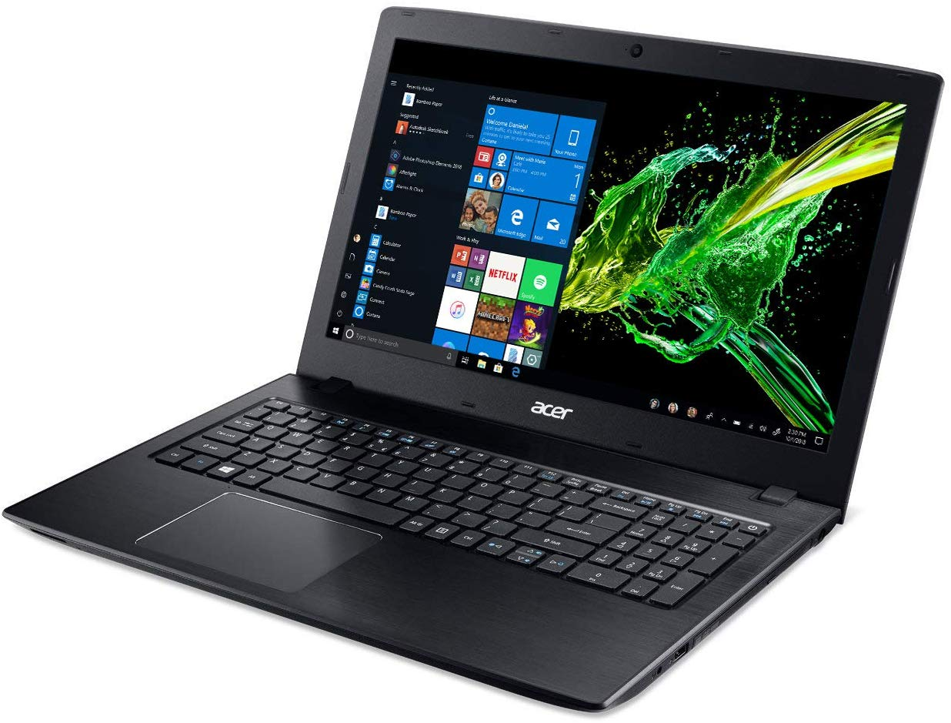
Product Level Summary
B075FLBJV7
Acer Aspire E 15 Laptop, 15.6" Full HD, 8th Gen Intel Core i5-8250U, GeForce MX150, 8GB RAM Memory, 256GB SSD, E5-576G-5762
Mid-end product, $900
No Heating because no gaming
Make and build is solid
Reviews talks Customer Experience

Slide 14

Product Level Summary
B01DBGVB7K
ASUS Chromebook C202SA-YS02 11.6" Ruggedized and Water Resistant Design with 180 Degree (Intel Celeron 4 GB, 16GB eMMC
Lower-end product, $200
Chromebook, friends and family gift
People do not care about specs
Reviews talks about family and work

Slide 15
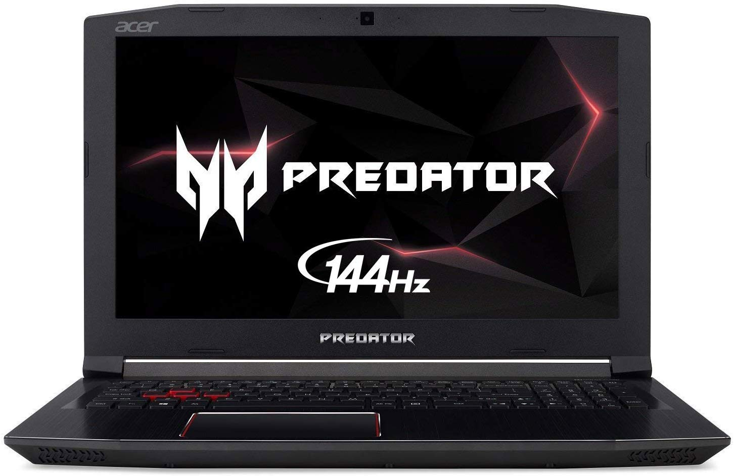
Product Level Summary
B07CTHLX8C
Acer Predator Helios 300 Gaming Laptop PC, 15.6" FHD IPS w/ 144Hz Refresh, Intel i7-8750H, GTX 1060 6GB, 16GB DDR4, 256GB NVMe SSD
Gaming Laptop, $1000
People buy this laptop to play games
Performance for gaming
Heating problem

Slide 16
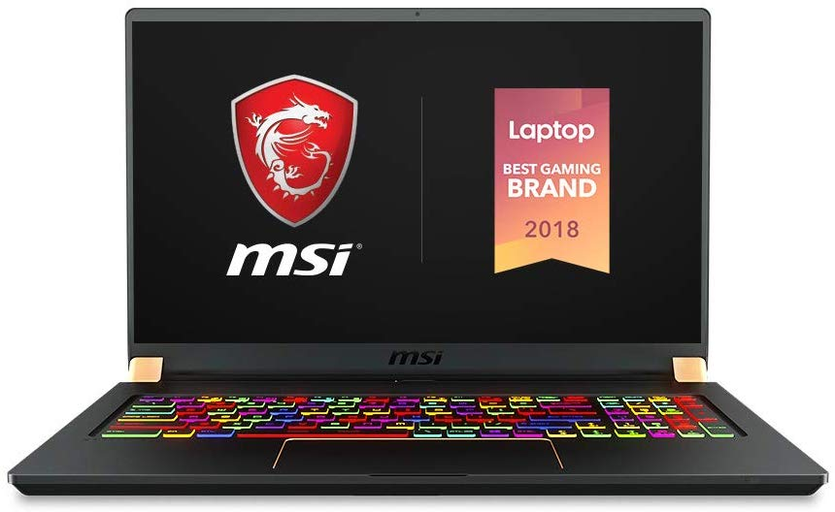
Product Level Summary
MSI GS75 Stealth-093 17.3" Razor Thin Bezel Gaming Laptop NVIDIA RTX 2080 8G Max-Q, 144Hz 3ms, Intel i7-8750H (6 cores), 32GB, 512GB NVMe SSD, TB3, Per Key RGB, Win10H, Matte Black w/ Gold Diamond Cut
$3,000 High-end gaming laptop
Highest Performance Topic Score
Topic Score as measure of magnitude
26% reviews about performance

Slide 17
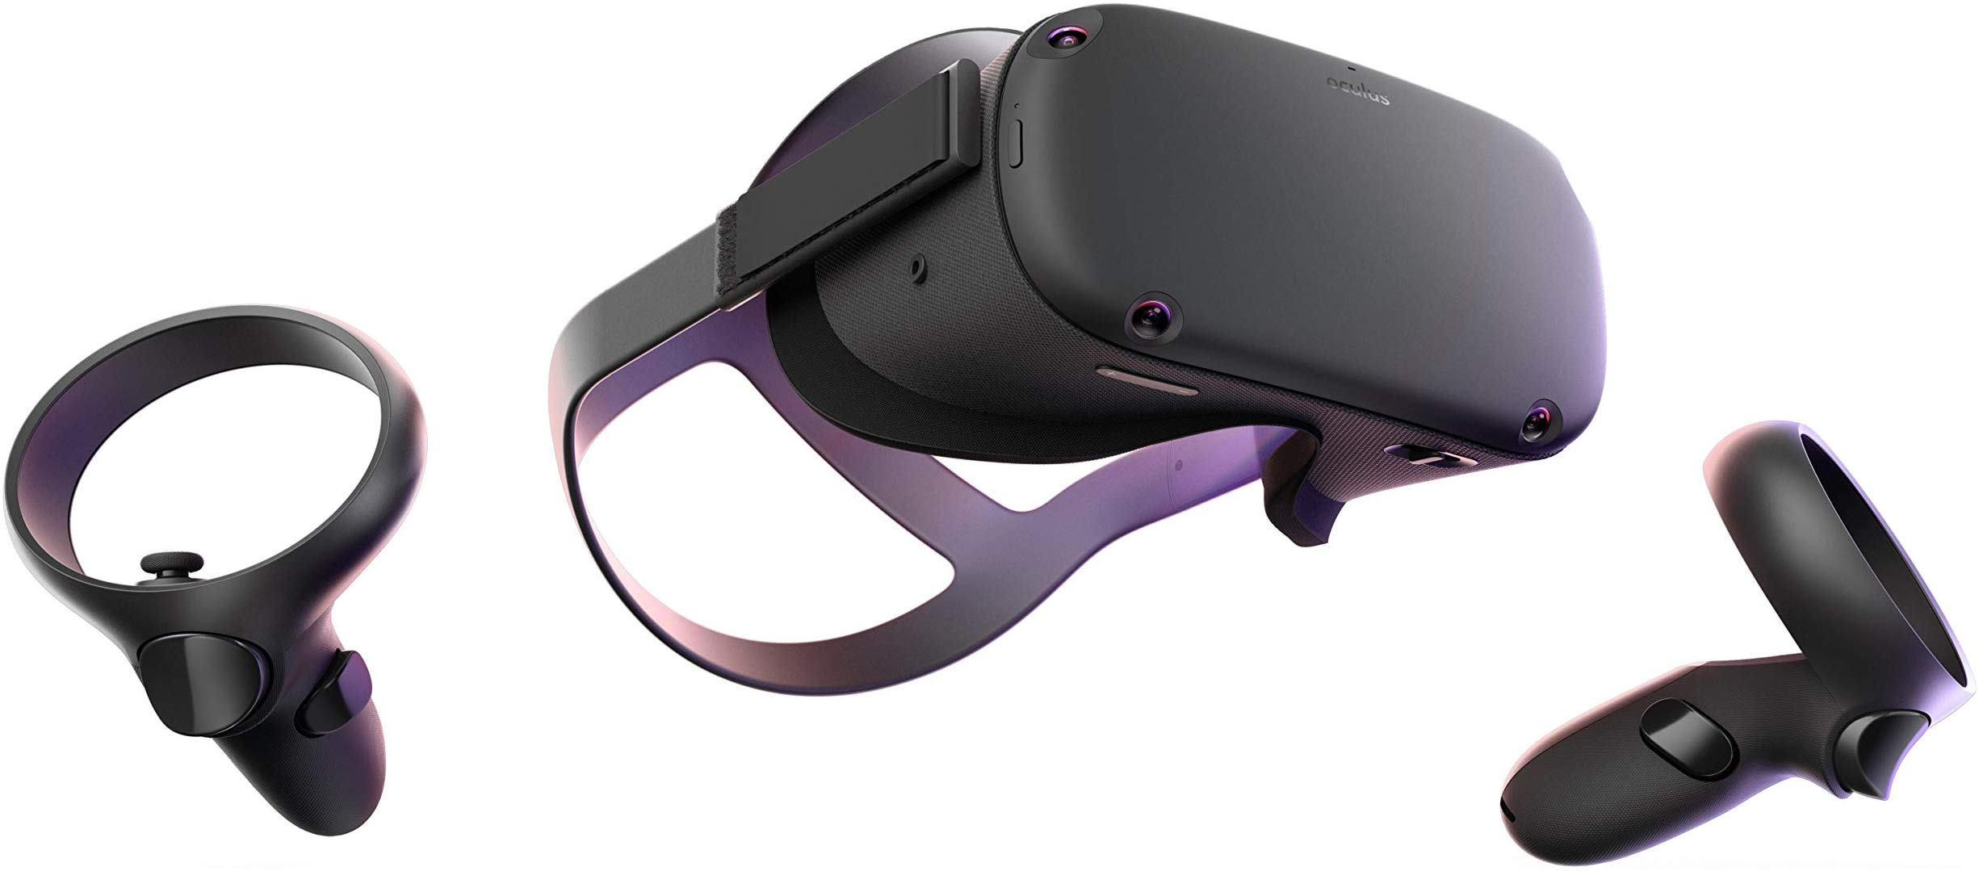

Product Level Summary
B00LDLR6FM Oculus
Topic Score as measure of magnitude
Oculus has 46% reviews about battery life

Slide 18
Topic Knowledge Example
Knowing each product, we can ask:
Which product has the best performance?
Actually the $2,999 gaming laptop
Which product has the most heating related reviews?
Mid-end gaming laptop Acer Predator
Which product has the shortest battery life?
Oculus, reviews are 46% related to battery life
A VR device with 2 hour battery life

Slide 19
Product Knowledge Example
Acer Aspire is versatile.
People buy cheap Chromebook for their sons.
The more money spent, the more gaming it is.
2.5 hours battery life is not enough for a VR device, and people are going to whine about it!
A bot can read reviews for you!

Slide 20

THANK YOU!
ANY QUESTIONS?

